Slide 1

Getting started…
Please sit in rows A through J only
Form groups of 3-5 students
Discuss: what are you most confused about?
Post questions on Ask For Me!

Slide 2
Sampling Distributions to Confidence Intervals
Psych 100A Spring 2019
Prof. Jim Stigler

Slide 3
This Week
Continue discussion of sampling distributions
Introduce confidence intervals

Slide 4
A sampling distribution is a distribution of sample statistics,
or estimates.

Slide 5
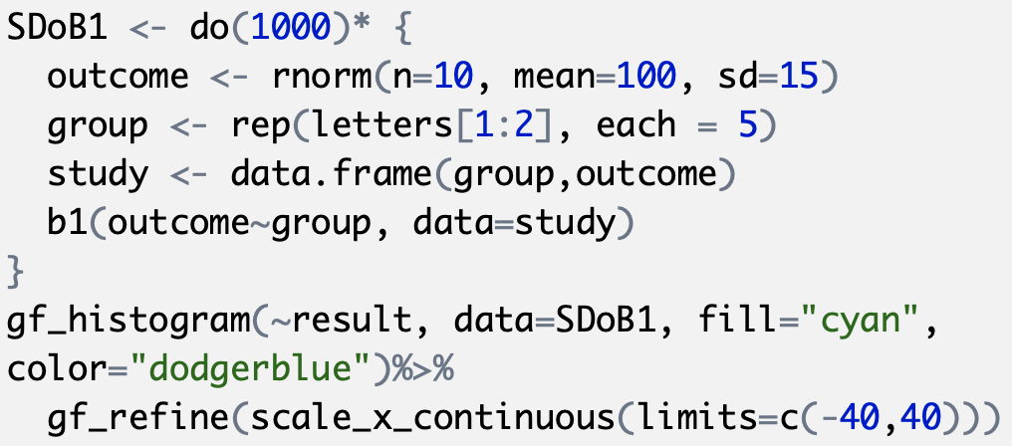
Constructing a Sampling Distribution of b1s…
bit.ly/100Aclass

Slide 6
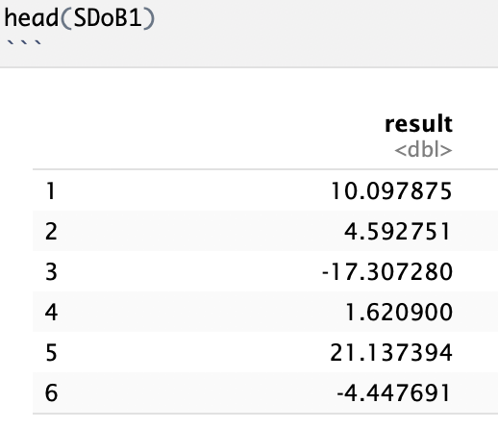

Look at head() of SDoB1.
What does each of these numbers represent?

Slide 7
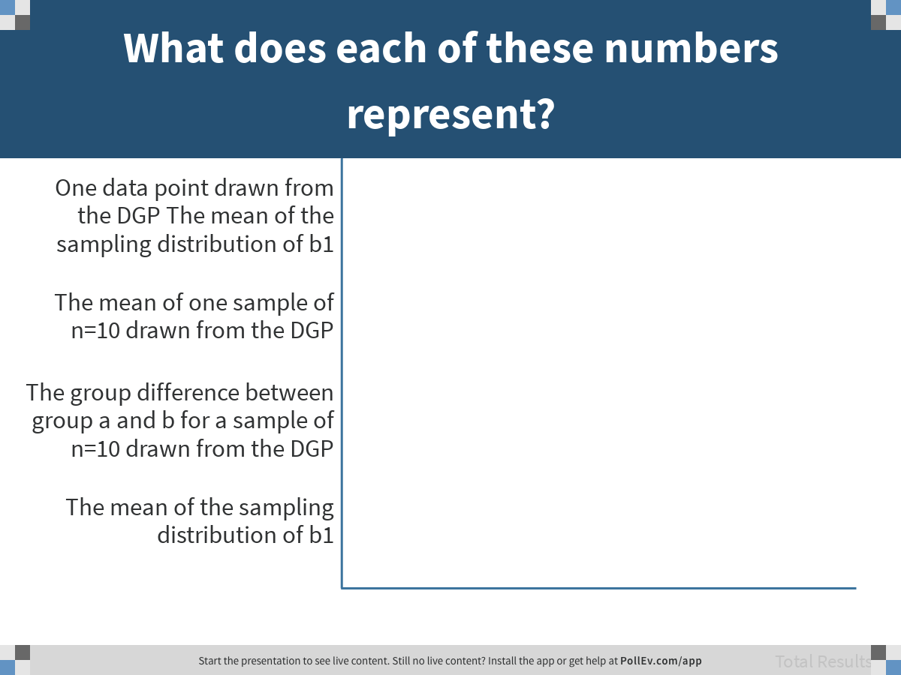
Notes:
What does each of these numbers represent?
https://www.polleverywhere.com/multiple_choice_polls/1dyBZpjUCgvunZZq6rPhS

Slide 8
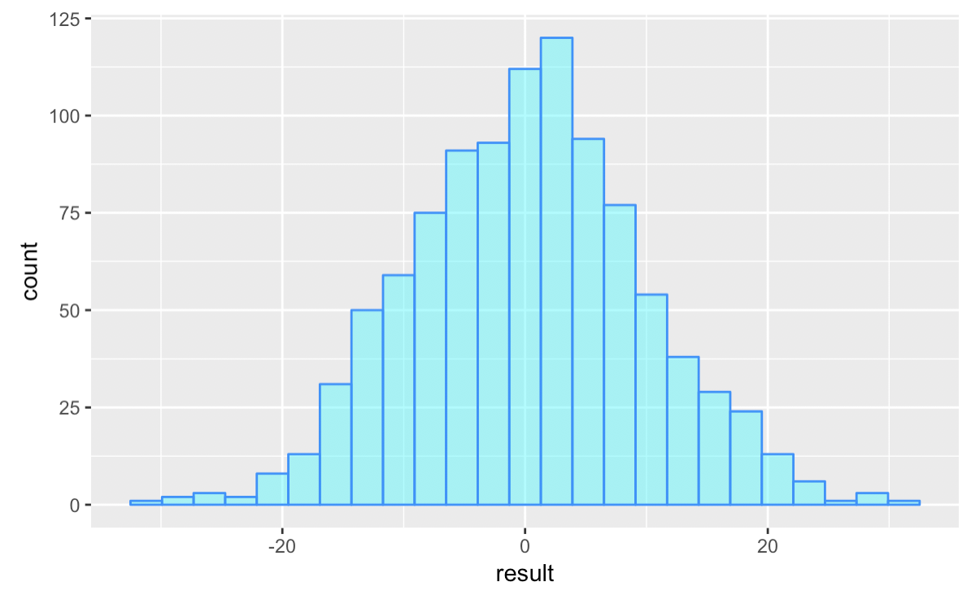
Sampling distribution of b1: What is “count” the count of?
Why do you think this distribution is centered at 0?

Slide 9
Learning to think with “If…”

Slide 10
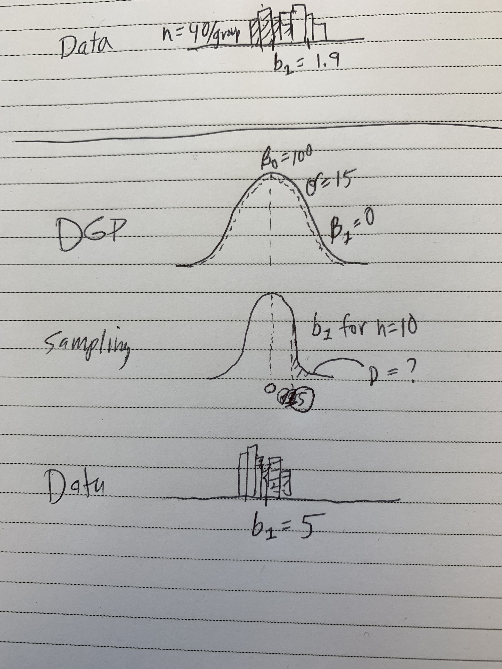
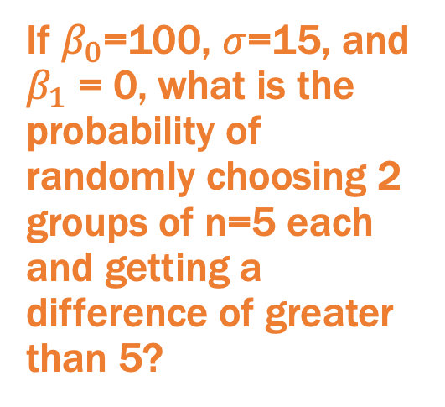
Remember our question
If $β_{0}$=100, $σ$=15, and $β_{1}$ = 0, what is the probability of randomly choosing 2 groups of n=5 each and getting a difference of greater than 5?
To answer this question we need to use the sampling distribution we just simulated.

Slide 11
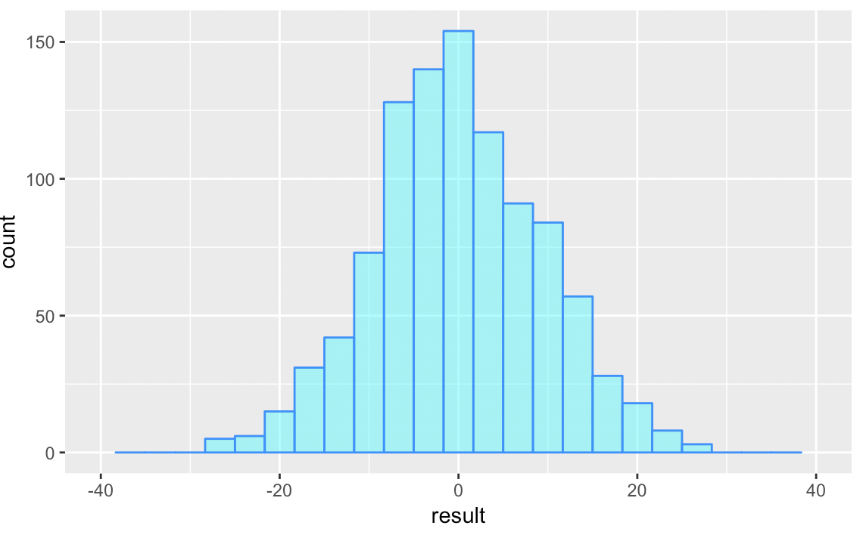
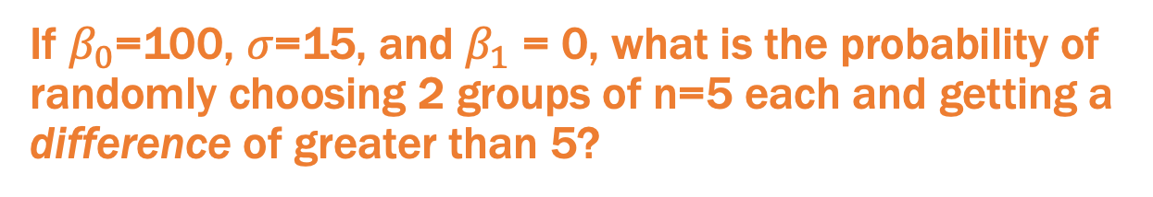
We use a sampling distribution to answer this question
If $β_{0}$=100, $σ$=15, and $β_{1}$ = 0, what is the probability of randomly choosing 2 groups of n=5 each and getting a difference of greater than 5?
p = ?

Slide 12

We use a sampling distribution to answer this question
If $β_{0}$=100, $σ$=15, and $β_{1}$ = 0, what is the probability of randomly choosing 2 groups of n=5 each and getting a difference of greater than 5?
Key is finding standard error!
p = ?

Slide 13
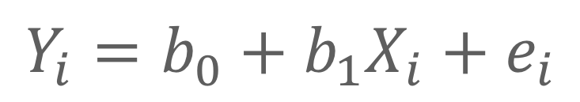

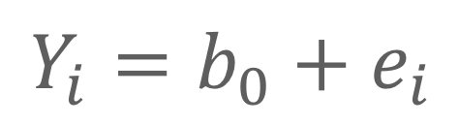
Casting the Question as Model Comparison
Two-group model:
$$Y_{i}=b_{0}+b_{1}X_{i}+e_{i}$$
Empty model:
5
$$Y_{i}=b_{0}+e_{i}$$
Question: What are the chances that our sample estimate $b_{1}$could have come from a DGP with $β_{1}$= 0?

Slide 14
Some more “what if”s

Slide 15
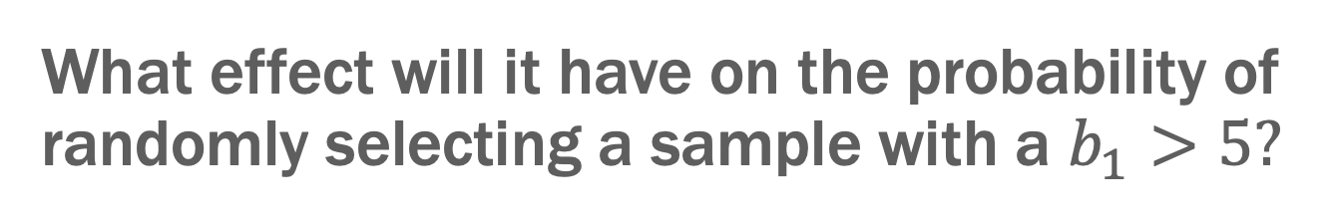
What effect will it have on the probability of randomly selecting a sample with a $b_{1}>5?$
If we change do(1000) to do(500)…

Slide 16
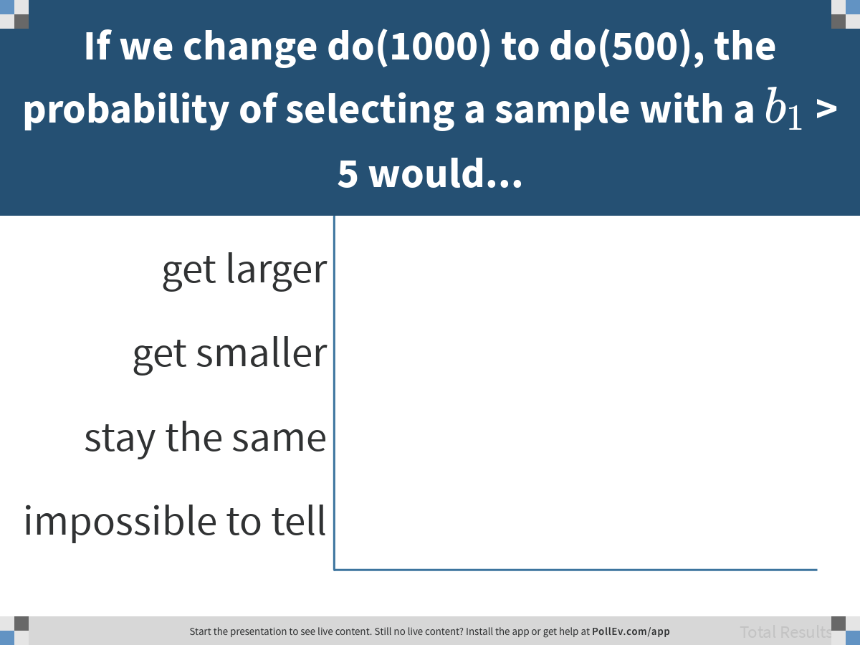
Notes:
If we change do(1000) to do(500), the probability of selecting a sample with a $$b_1$$ > 5 would...
https://www.polleverywhere.com/multiple_choice_polls/8WlZuGkeJ5F79RAsfihz5

Slide 17
What effect will it have on the probability of randomly selecting a sample with a $b_{1}>5?$
If we change n=10 to n=40…

Slide 18
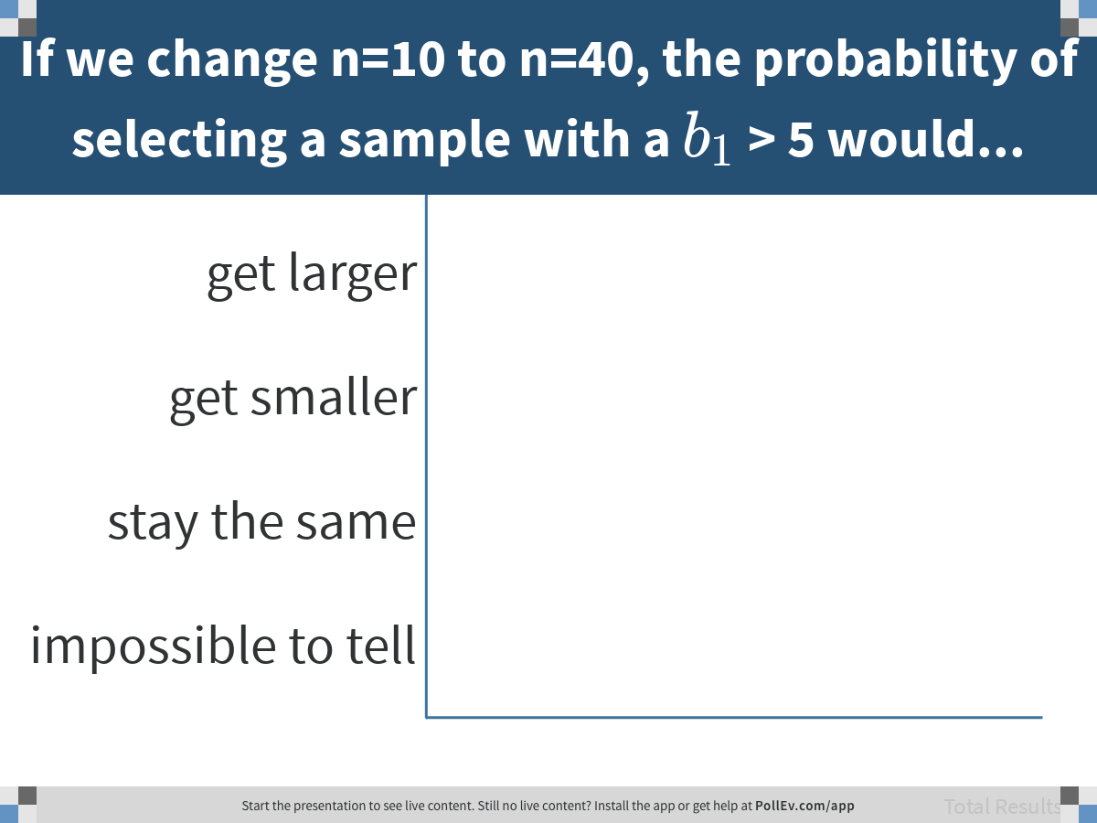
Notes:
If we change n=10 to n=40, the probability of selecting a sample with a $$b_1$$ > 5 would...
https://www.polleverywhere.com/multiple_choice_polls/wBlvMYEJ3Fmpt9j31OOvE

Slide 19
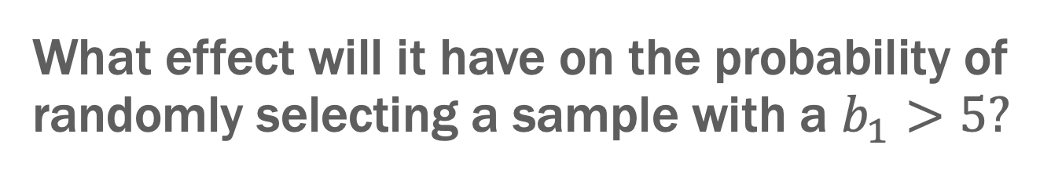
What effect will it have on the probability of randomly selecting a sample with a $b_{1}>5?$
If we change the mean of DGP from 100 to 120…

Slide 20
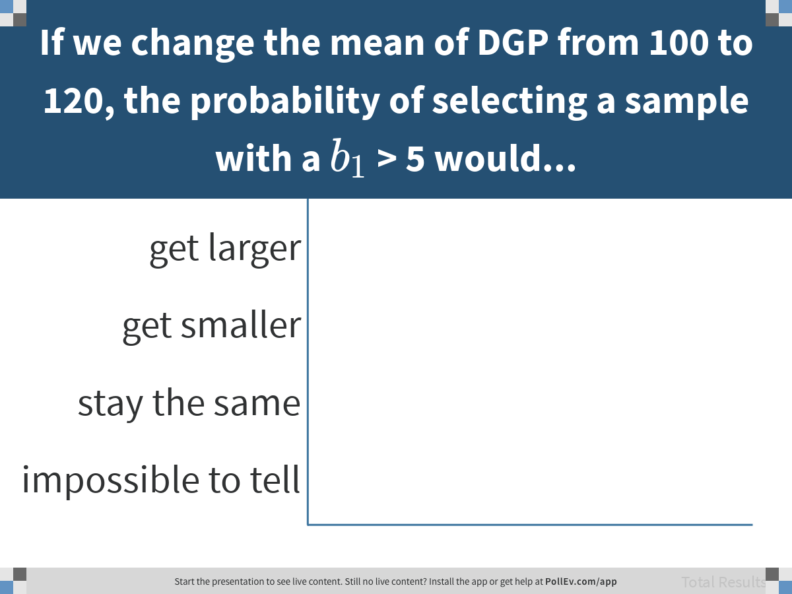
Notes:
If we change the mean of DGP from 100 to 120, the probability of selecting a sample with a $$b_1$$ > 5 would...
https://www.polleverywhere.com/multiple_choice_polls/2M9m4UFfMPopQl9Ma0nOX

Slide 21

What effect will it have on the probability of randomly selecting a sample with a $b_{1}>5?$
If we change SD of DGP from 15 to 30…

Slide 22
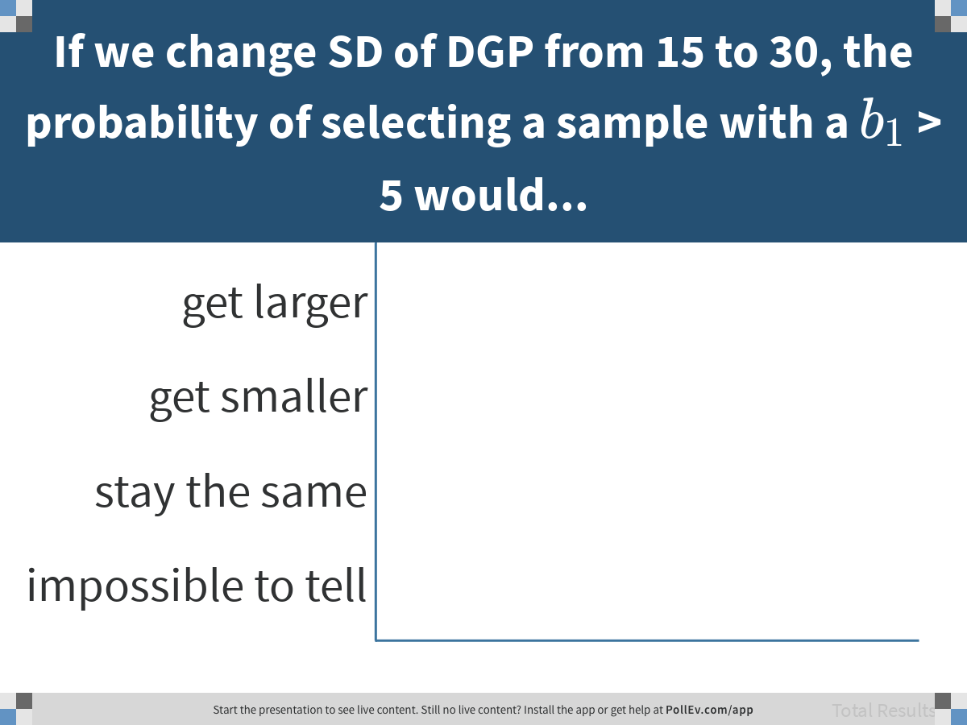
Notes:
If we change SD of DGP from 15 to 30, the probability of selecting a sample with a $$b_1$$ > 5 would...
https://www.polleverywhere.com/multiple_choice_polls/eo90vkPhzQMb2qKwivSuI

Slide 23
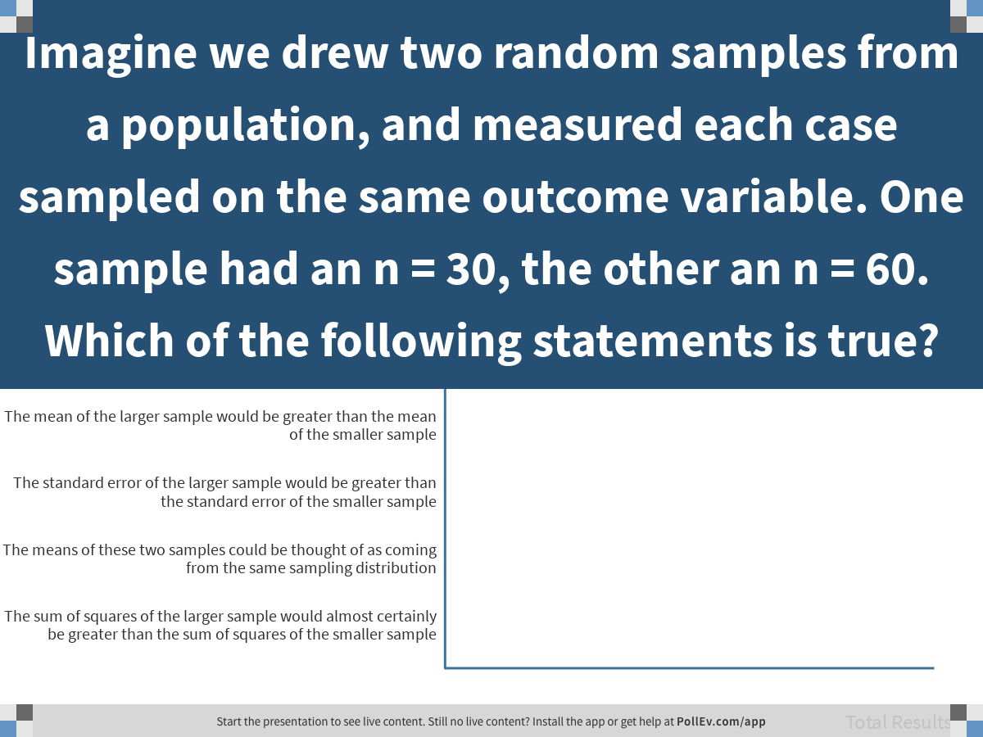
Notes:
Imagine we drew two random samples from a population, and measured each case sampled on the same outcome variable. One sample had an n = 30, the other an n = 60. Which of the following statements is true?
https://www.polleverywhere.com/multiple_choice_polls/8by3ZsTsqMGlqbhAVXUfZ

Slide 24
Which distribution?

Slide 25
Which distribution should I use?
I’m making a new ride for a theme park. It’s not safe for anyone less then 60 inches tall to ride on it. What percentage of park attendees will be ineligible to ride?
DGP? Or sampling distribution?

Slide 26
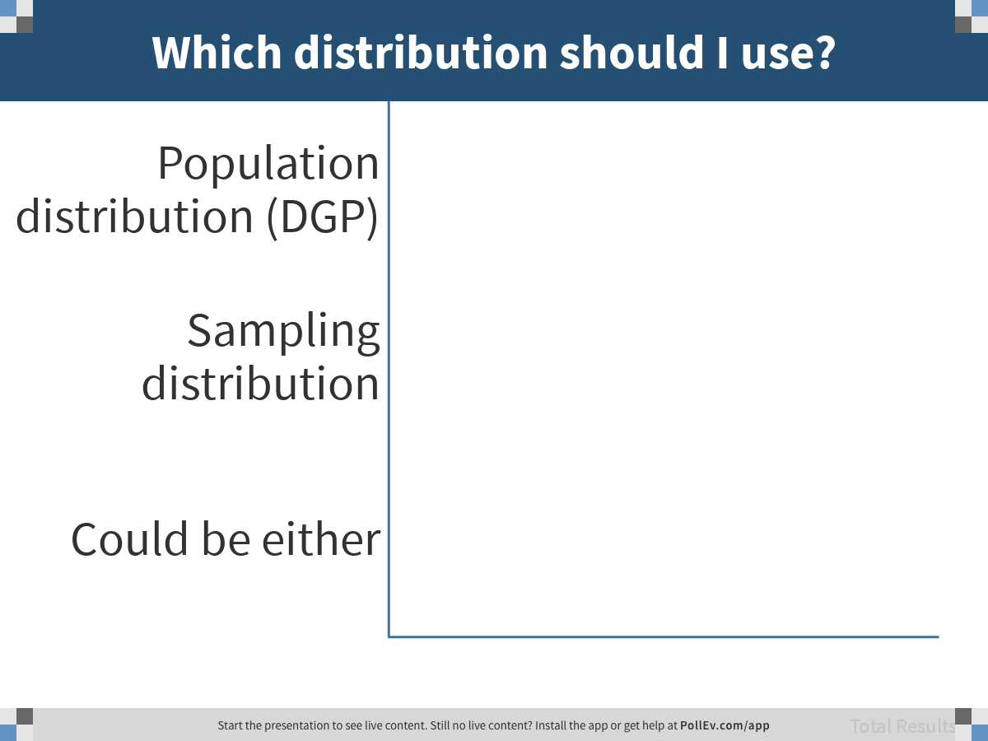
Notes:
Which distribution should I use?
https://www.polleverywhere.com/multiple_choice_polls/UZxGLLvtrZuM2XmmpL9O2

Slide 27
Which distribution should I use?
In order to get state approval for my ride, I need to show that the average weight of the 10 people that fit into each car will be less than 150 pounds 99.9% of the time.
DGP? Or sampling distribution?

Slide 28
Notes:
Which distribution should I use?
https://www.polleverywhere.com/multiple_choice_polls/HS1BN4tv2s0998icAQnJ5

Slide 29
In your groups
Think up two questions, one that can be answered in reference to a population distribution, and another that would require a sampling distribution.

